Slide 1
Impact of Social Media on Education
FAST University
By

Slide 2
Table of Contents
Introduction
Research Problem, Significance
Literature Review
Work already done on this filed
Findings
What data did we collect
Discussion
Analysis of our data
Conclusion
What can we conclude
Recommendation
What would we recommend

Slide 3


1
INTRODUCTION

Slide 4

Research Problem
Intro
What kind of impact does the social networking sites have on education of students. The impact of social media on education is productive or destructive?

Slide 5
Introduction
Methodology
-Quantitative Approach
-Questionnaire
Objective
-Finding the factors between education and social media
-Explore possibilities in which students can be benefited
Significance
-Raise awareness about positive and negative aspects of social media
-Help in the betterment of academic performances of students

Slide 6


2
Literature Review

Slide 7
Literature Review
Overview of Social Media
Usage of Social Media
-It is an essential need of our daily lives
(Waqas, Madiha)
-It is usually used for communication and data sharing
(Wang, Waqas and Madiha)
-Previous research show around 90% student use social media
(Waqas,Madiha)
-Student use social media minimum half hour a day as a part of their daily routine
(Shazad khan)

Slide 8
Literature Review
Students on Social media
It’s impact on education
-Some students use social network for productive purpose and other use social media for harmful and useless purpose.
(Wang)
-Social media grabs the attention of students
(Shazad, Waqas and Madiha)
-It effect student life and grades
(Shahzad and Gingay)
-63.4% of the student prefer chatting on social media than using for academic purpose
(Student of Koforidua)

Slide 9


3
Facts and Findings

Slide 10
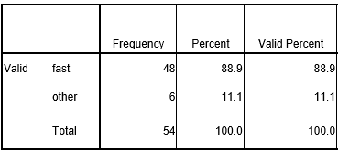
Facts and Findings
Name of the universities from where the data was collected
This shows that our results and conclusion will be limited to the students of FAST universities. We do have some data from other universities as well but it's only 11.1% which is negligible.

Slide 11
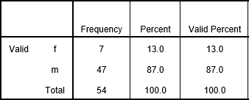
Facts and Findings
The ratio of males and females in our data collection
The majority is males with 87 %. The reason for these results is that because our collection was mostly performed at FAST university and the ratio of girls is very few in the Karachi campus of FAST.

Slide 12
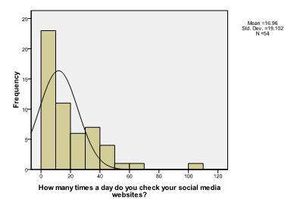
How many times do you use social networking sites in a day?
-An average student uses social media website about 17 times a day.
-Majority of them use more than 10 times a day.
-Usage varies a lot from person to person.

Slide 13
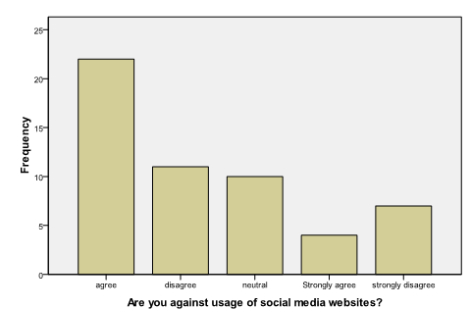
How many students are against the usage of social networking sites?
-48% of the population is against social media usage with 7% having an strong opinion.
-About 33% of the population is in favor of social media usage.
-It can be clearly said the majority is against social media usage.

Slide 14
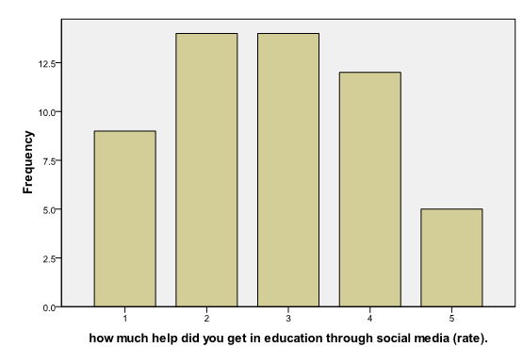
How much help do you get in education through social media?
-Social media plays good role in helping students as most students believes it helpful them.
-Average of 2.81 rating out of 5.
-Maximum frequency being equal for both 2 and 3.

Slide 15





Most helpful Social Network?
Others
2%
Twitter
9%
Linkedin
9%
Whatsapp
39%
Facebook
41%
Facebook is the most dominant in the student world with 40% users. And Whatsapp comes next after Facebook for being the most helpful social network regarding education. Facebook consists of groups and pages while Whatsapp helps in sharing screenshots and snapshots of notes.
Notes:
no slide master

Slide 16

4
Discussion

Slide 17

Discussion
1
Facebook and Whatsapp Win
Facebook and Whatsapp are most helpful in education.
2
Usage has increased
People tend to use social networking more compared to the results of the previous researches.
3
Hatred has increased
Students are mostly against the use of social media.
4
Social Media is productive
Majority of students did claim that they get help from social networking.

Slide 18


5
Conclusion

Slide 19
Conclusion
Average usage of 16 times a day.
Usage of Social Network
Approx. half the respondents were in the favor of usage.
In favour or against?
Facts in parallel with previous studies i.e. WAQAS TARIQ et al.
Compare and Contrast
Two platforms helping in education: FACEBOOK and WHATSAPP.
Helpful Platfoms

Slide 20

3
Recommendation

Slide 21
Recommendation
Platforms to be encouraged are Facebook and Whatsapp.
Help in sharing materials.
Group discussions by making private educational groups on Facebook.
More platforms should be discouraged that are not useful for education.
Hindrance in education
Notes:
http://dotcolon.net/font/route159/
https://www.google.com/fonts/specimen/Open+Sans

Slide 22
Thank You!
Any questions? I hope not :D

